Slide 1









Shaping the future of
Remote Desktop Services
Freek Berson
Remoting Windows enthusiast
@fberson
freek@rdmi.cloud
themicrosoftplatform.net

Slide 2
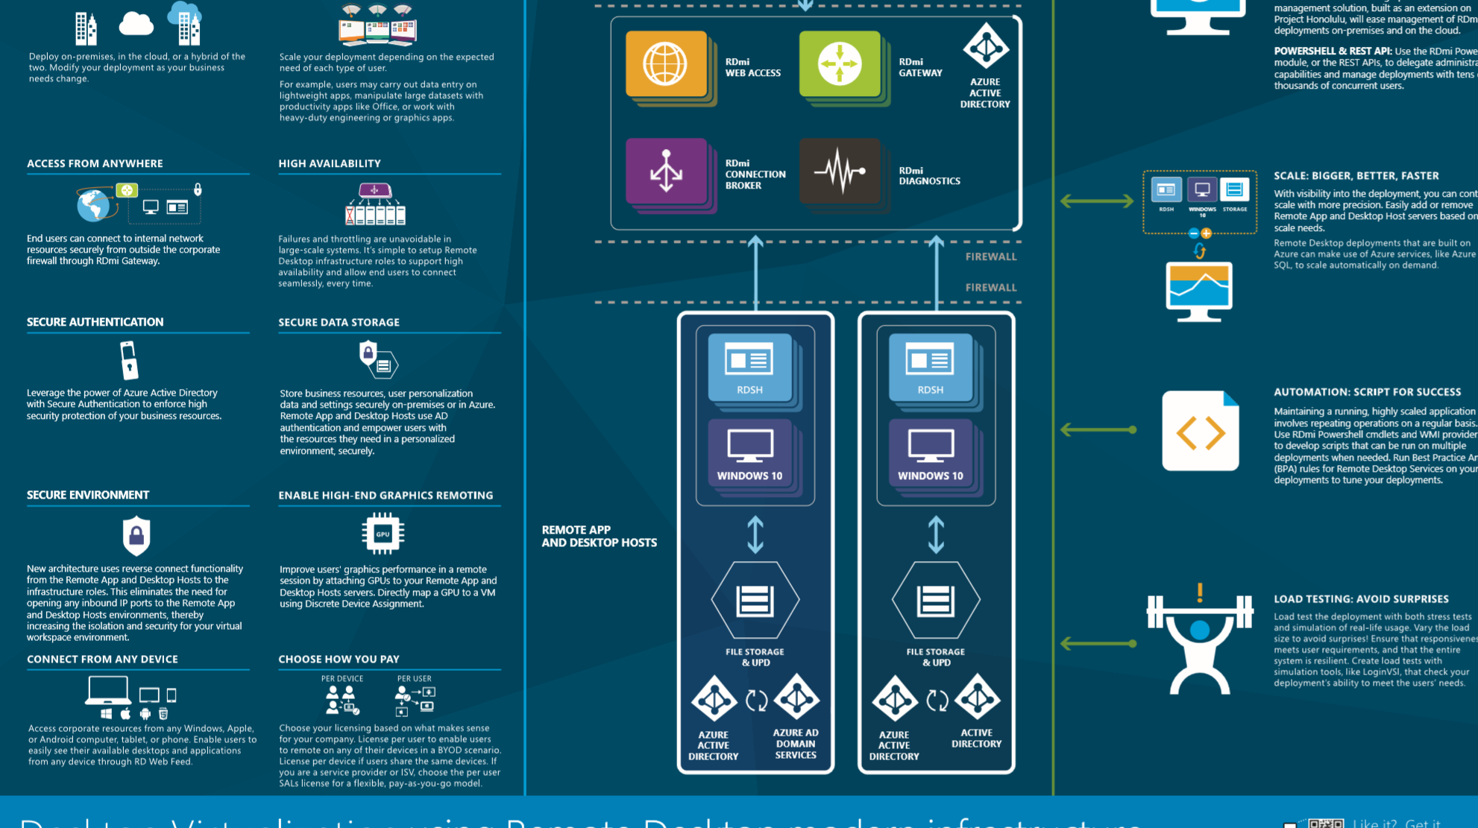




agenda
Going beyond RDS on IaaS
Remote Desktop modern infrastructure
HTML5
@fberson

Slide 3











RDS 2016 on Azure IaaS
RD Clients
RD Infrastructure
RD session hosts
Azure AD
iaas
DESKTOPS
apps
RD Web
UPD
File Server
Active Directory
RD gateway
RD broker
firewall
Paas
Azure AD
Domain Services
Azure SQL Database
@fberson

Slide 4



RDmi
RD Clients
RD Infrastructure
RD session hosts & Win10
1
Azure AD
Azure AD
A
A
iaas
2
0
DESKTOPS
apps
firewall
RD Web
RD diagnostics
3
4
5
UPD
6
Paas
Azure AD
Domain Services
Azure files
firewall
RD gateway
RD broker
firewall
RD session hosts & Win10
Azure AD
RD REST API
A
A
Azure SQL Database
DESKTOPS
apps
firewall
iaas
UPD
RD powershell
Active Directory
File server
@fberson
…

Slide 5
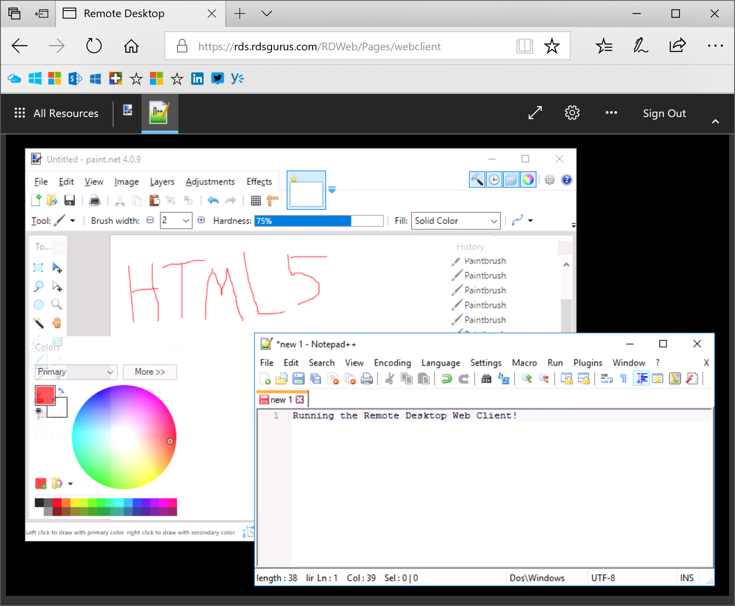
Html5
Clientless access (modern browser)
Available in RDmi
Ported back to RDS 2016
@fberson

Slide 6
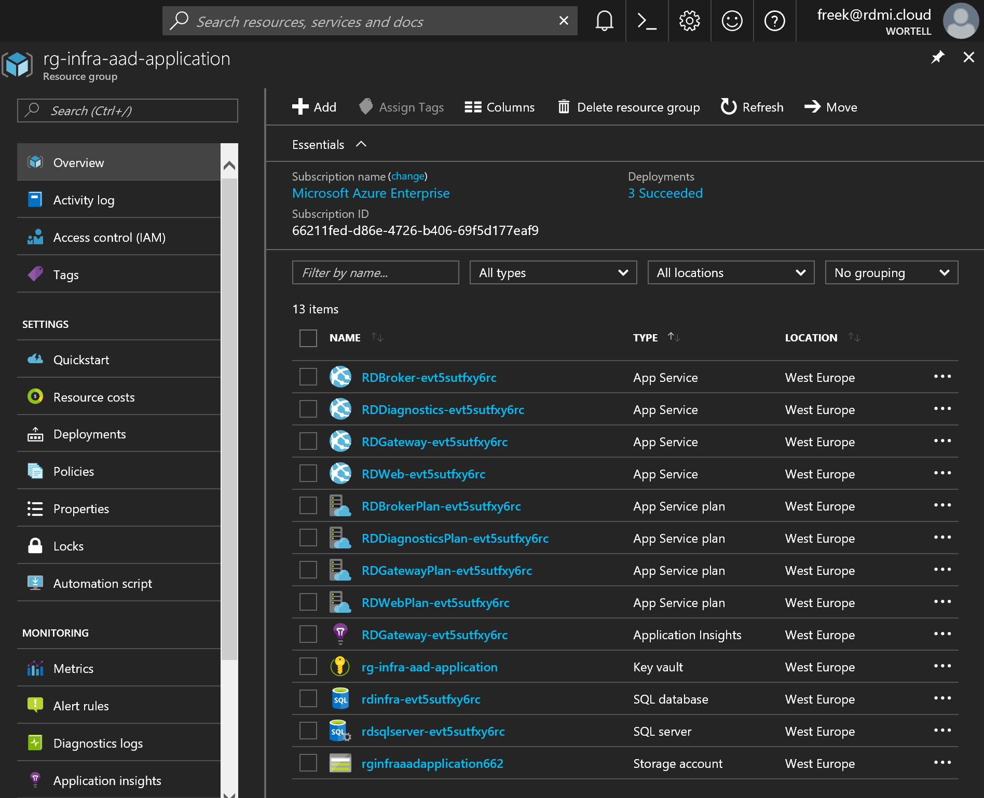
demo
@fberson

Slide 7



Recap & call to action
Remote Desktop modern infrastructure
Public Preview expected soon
GA, together after RS4
HTML5
Public Preview expected soon
Project Honolulu
Public Preview is available
→ Reach out: freek@rdmi.cloud / @fberson
@fberson

Slide 8
THANK YOU!
Freek Berson
Remoting Windows enthusiast
@fberson
freek@rdmi.cloud
themicrosoftplatform.net

Slide 9

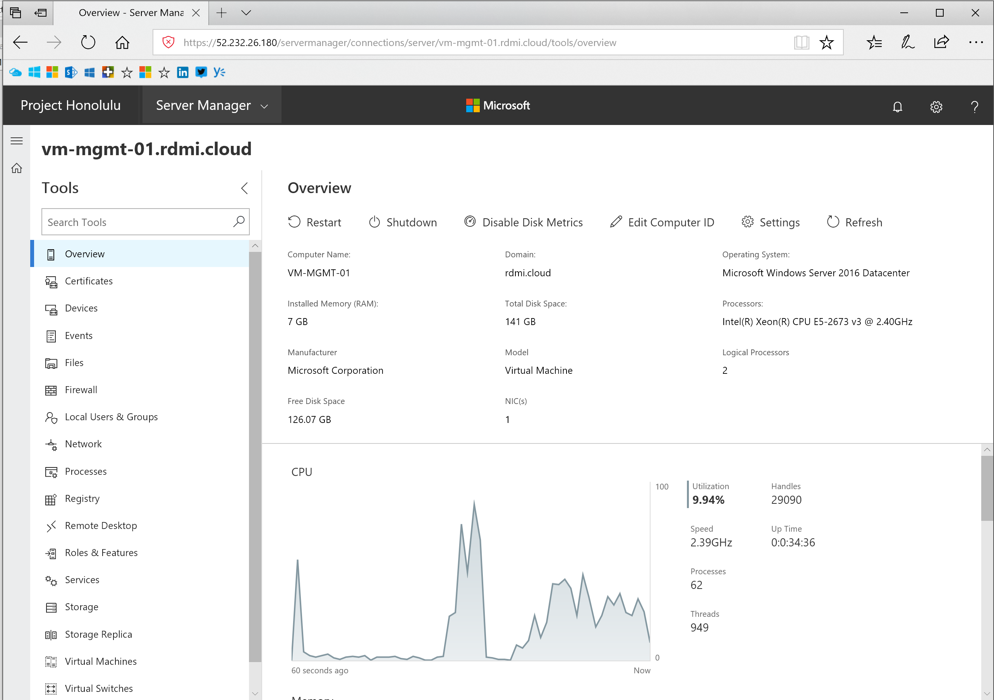
Project honolulu
@fberson

Slide 10
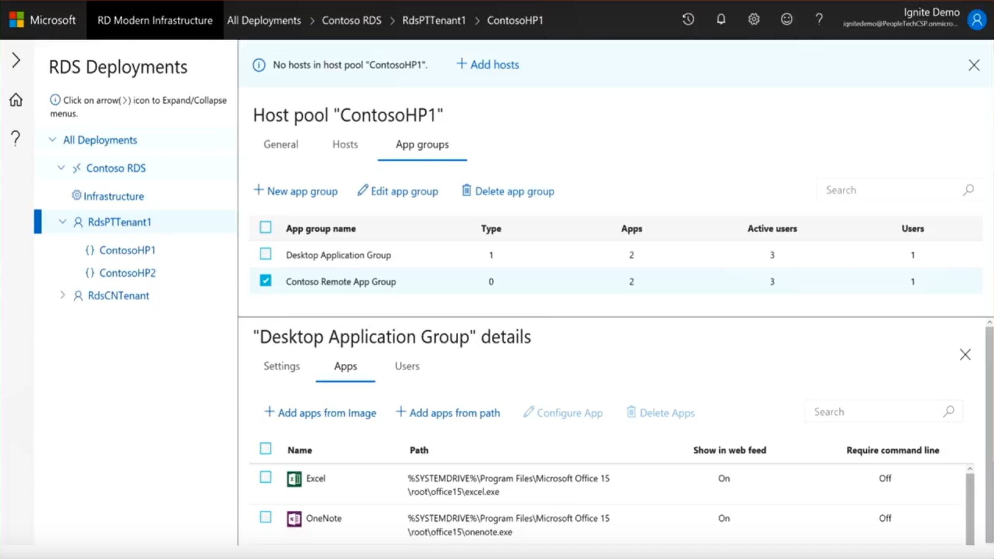
Honolulu rds example
@fberson

